Slide 1






From Bioeconomy Promise to Biodiversity Ceiling
The Role of Forest Biomass in Finnish Decarbonisation
Matthieu Bordenave
Sup: Pr. D’Alessandro and Pr. Jeanmart

Slide 2

Introduction
Notes:
PhD topic, example of check republic 2015 bark beetle, 2019 salvaging log
t EUR 1.12 billion (Toth et al., 2020)

Slide 3

Context
Physical risks
Storms, drought, pest, wildfires
Policy and management constraints
Forest managements, biodiversity, carbon sink, harvest rules
Potential other channels
Finance: credit risk, insurance, collateral
Policy reactions: subsidies, bans
…
Forest system
Mortality and growth
Harvest and logging
Quality shifts
Channel 1: Provisioning services to the real economy (level)
Biomass
Channel 2: Price Effects Channel
Economic losses
Bioenergy feedstock
Heat, power, fuels
Material wood
Construction, pulp, panels
Bio-based chemicals and bioplastics
Carbon tax
Price distortion
Price volatility
Due to supply shocks, sector losses
International Trade leakages

Slide 4
Context
Physical risks
Storms, drought, pest, wildfires
Policy and management constraints
Forest managements, biodiversity, carbon sink, harvest rules
Potential other channels
Finance: credit risk, insurance, collateral
Policy reactions: subsidies, bans
…
Forest system
Mortality and growth
Harvest and logging
Quality shifts
Channel 1: Provisioning services to the real economy (level)
Biomass
Channel 2: Price Effects Channel
Economic losses/risks
Bioenergy feedstock
Heat, power, fuels
Material wood
Construction, pulp, panels
Bio-based chemicals and bioplastics
Carbon tax
Price distortion
Price volatility
Due to supply shocks, sector losses
International Trade leakages

Slide 5
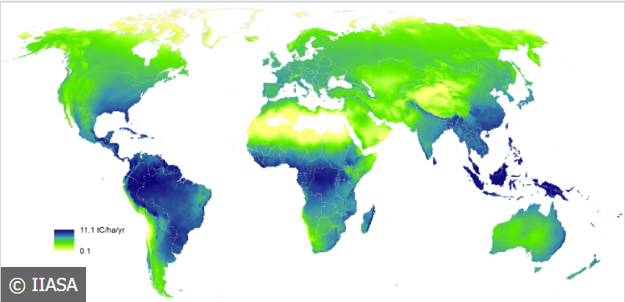
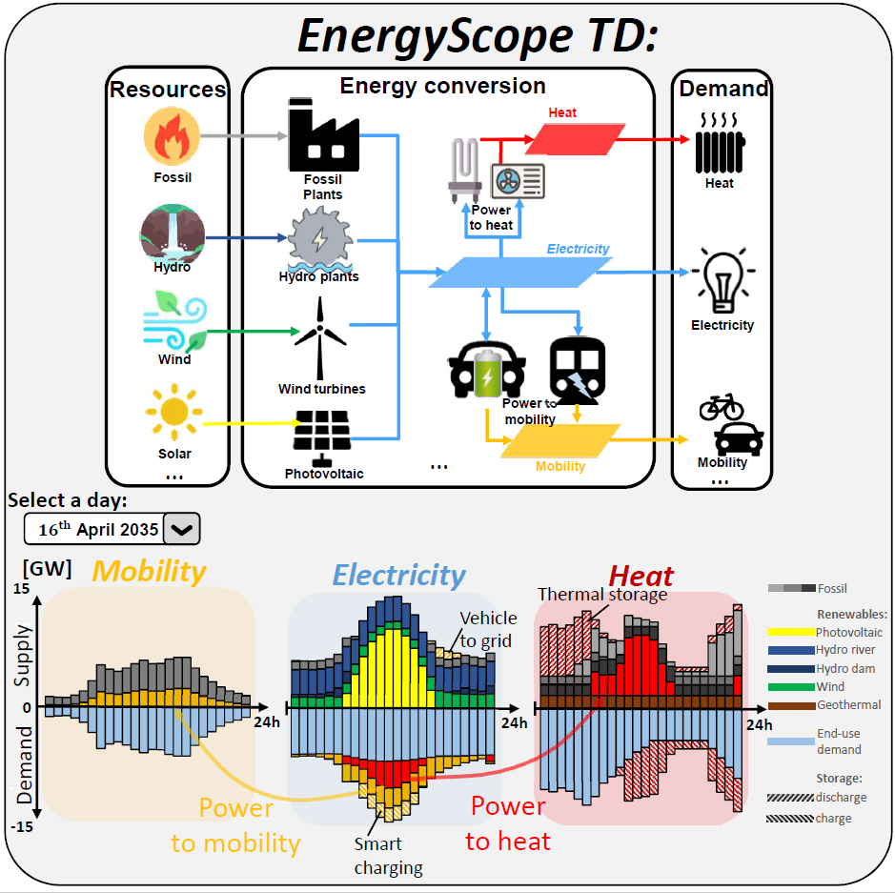
Methodology
Soft links, scenarios,
parameters
spatially explicit forest and physical risk model (IIASA)
Potentials
Physical risk scenario

Slide 6
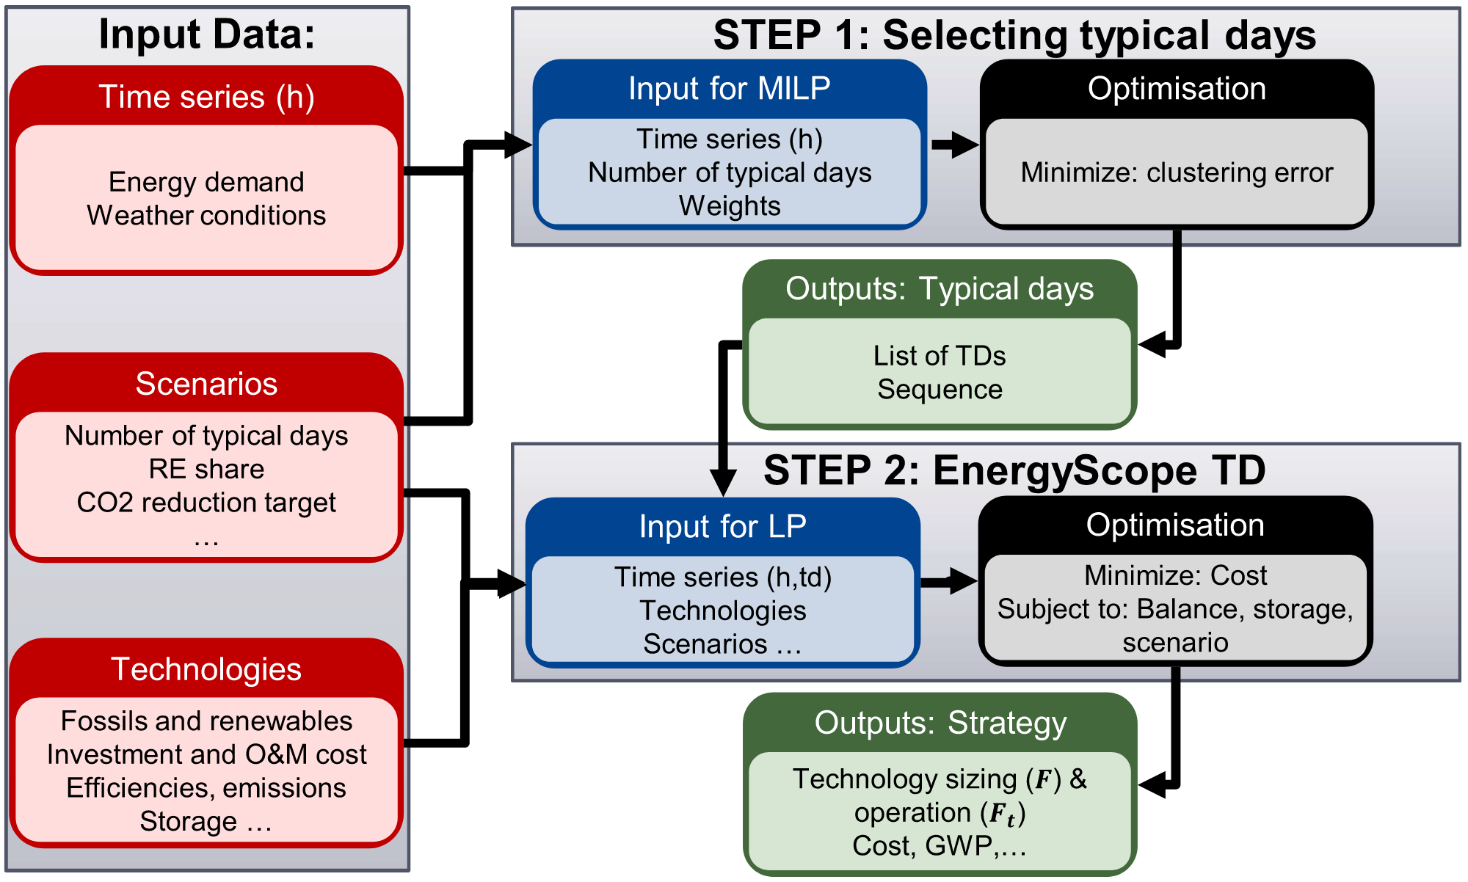
EnergyScope
presented in Limpens et al. (2019)

Slide 7
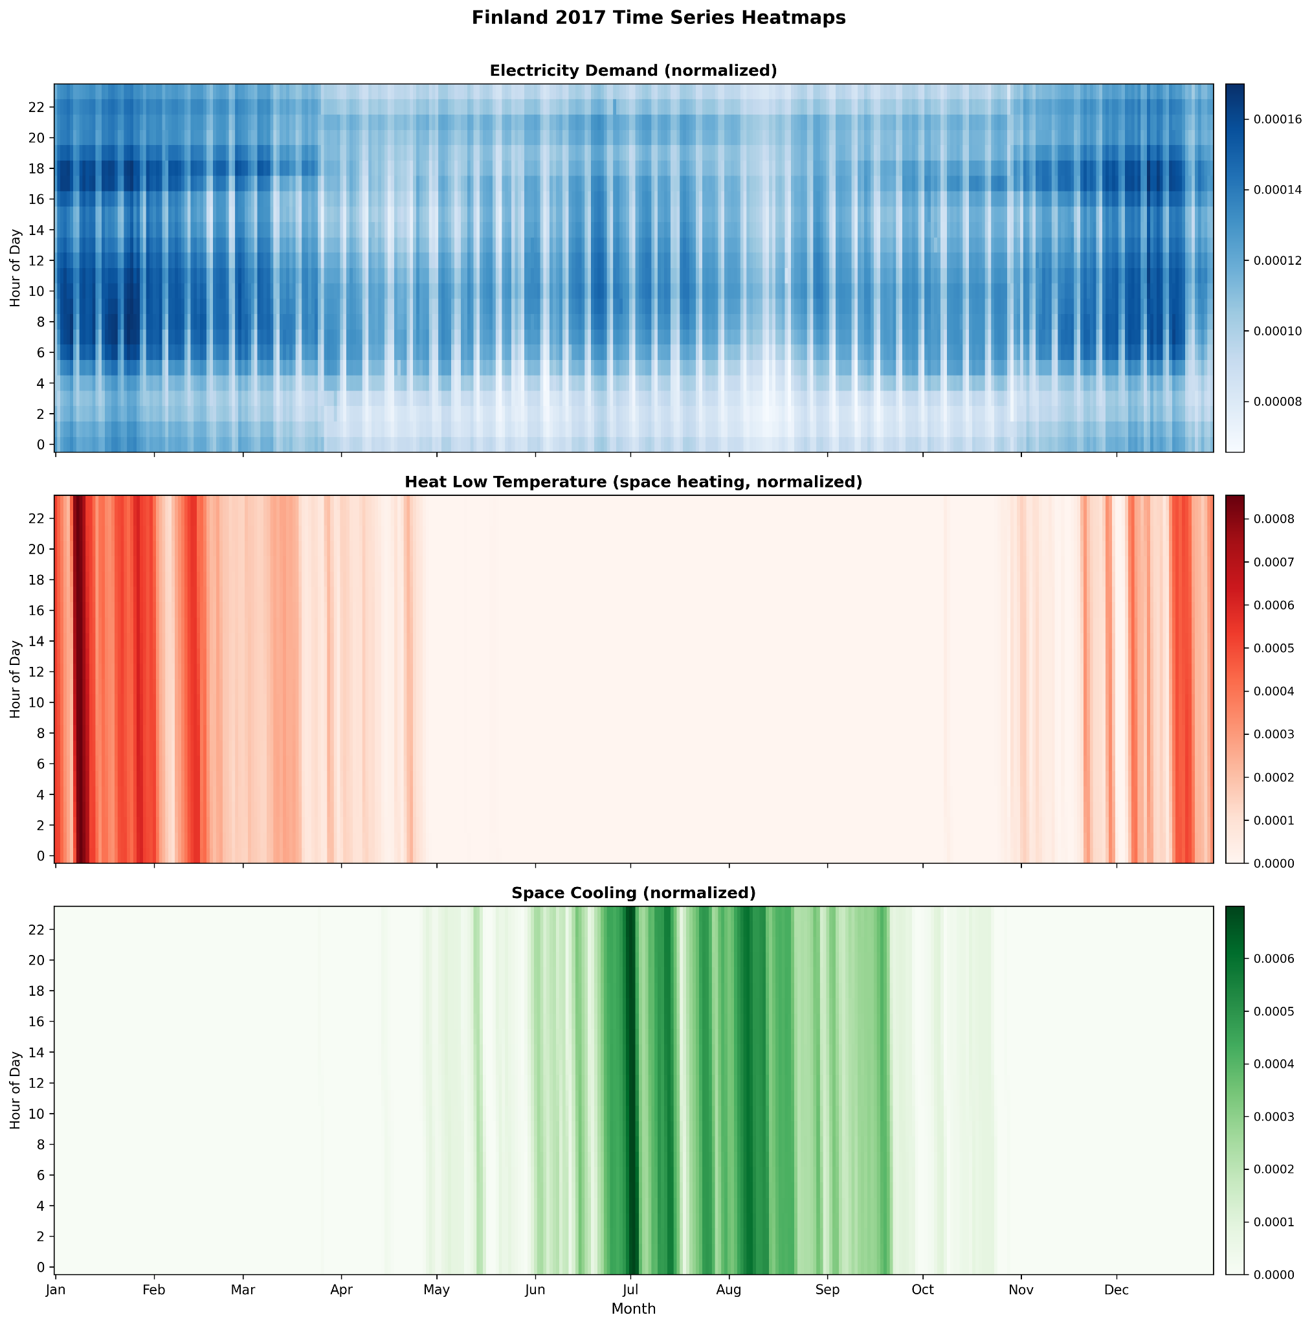
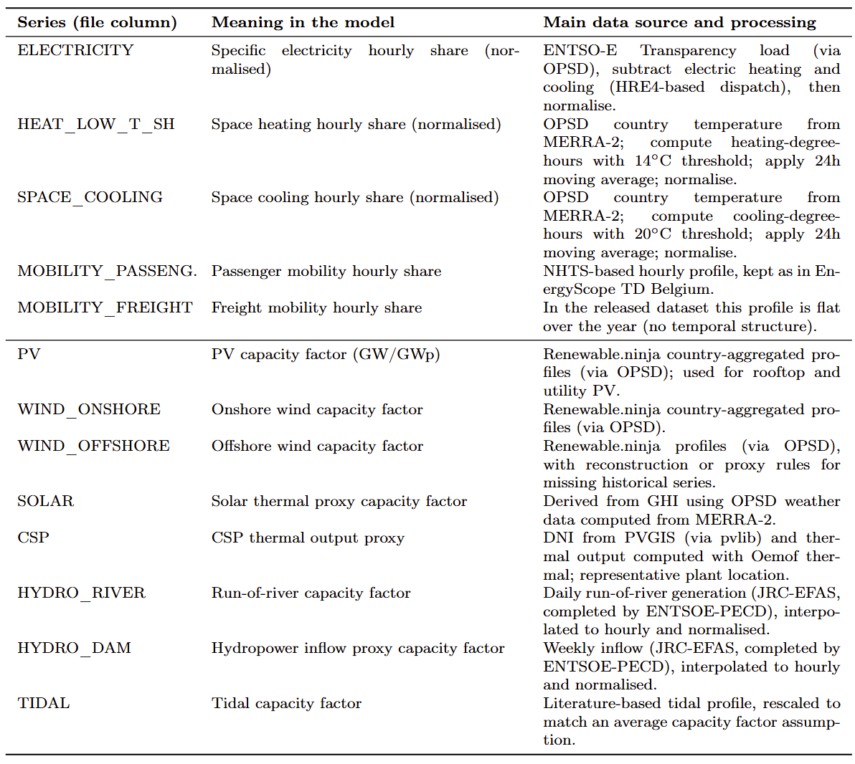
Typical days selection

Slide 8
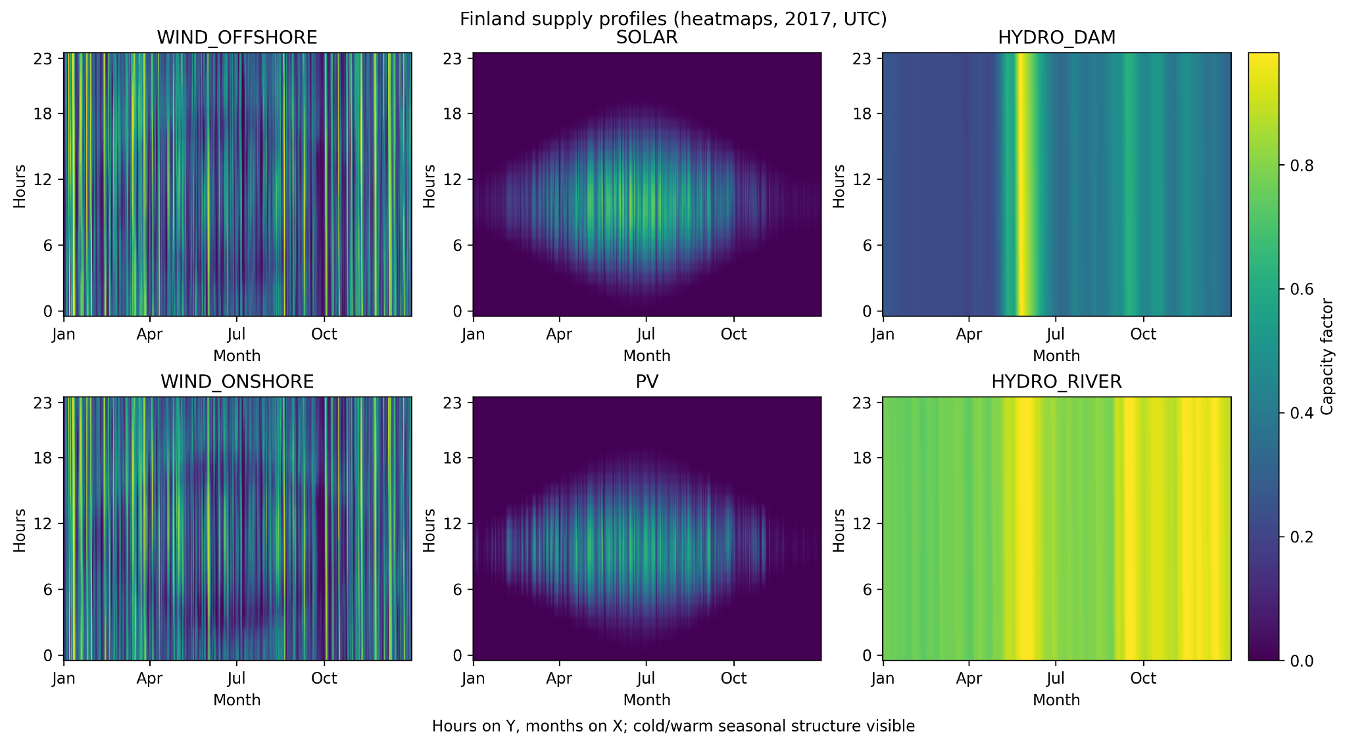
Typical days selection: RE supply cap.

Slide 9
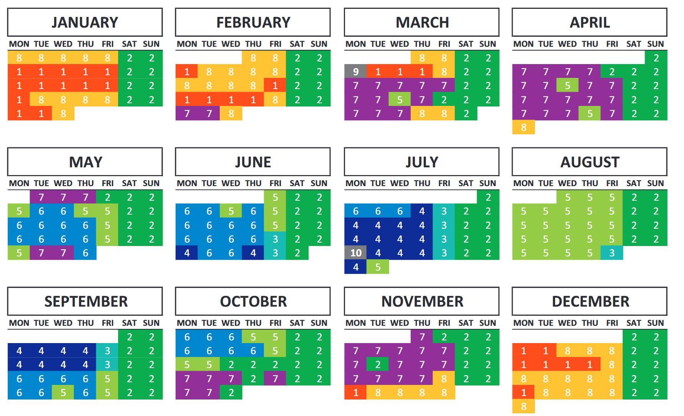
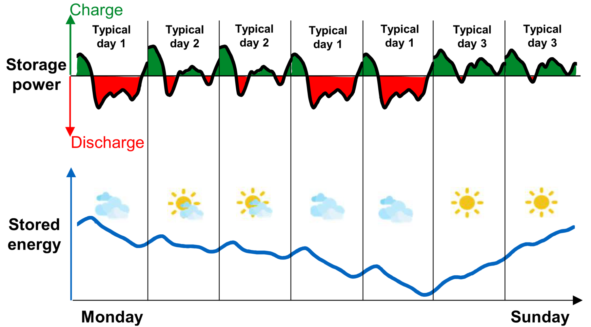
Typical days: an outlook
presented in Limpens et al. (2019)

Slide 10
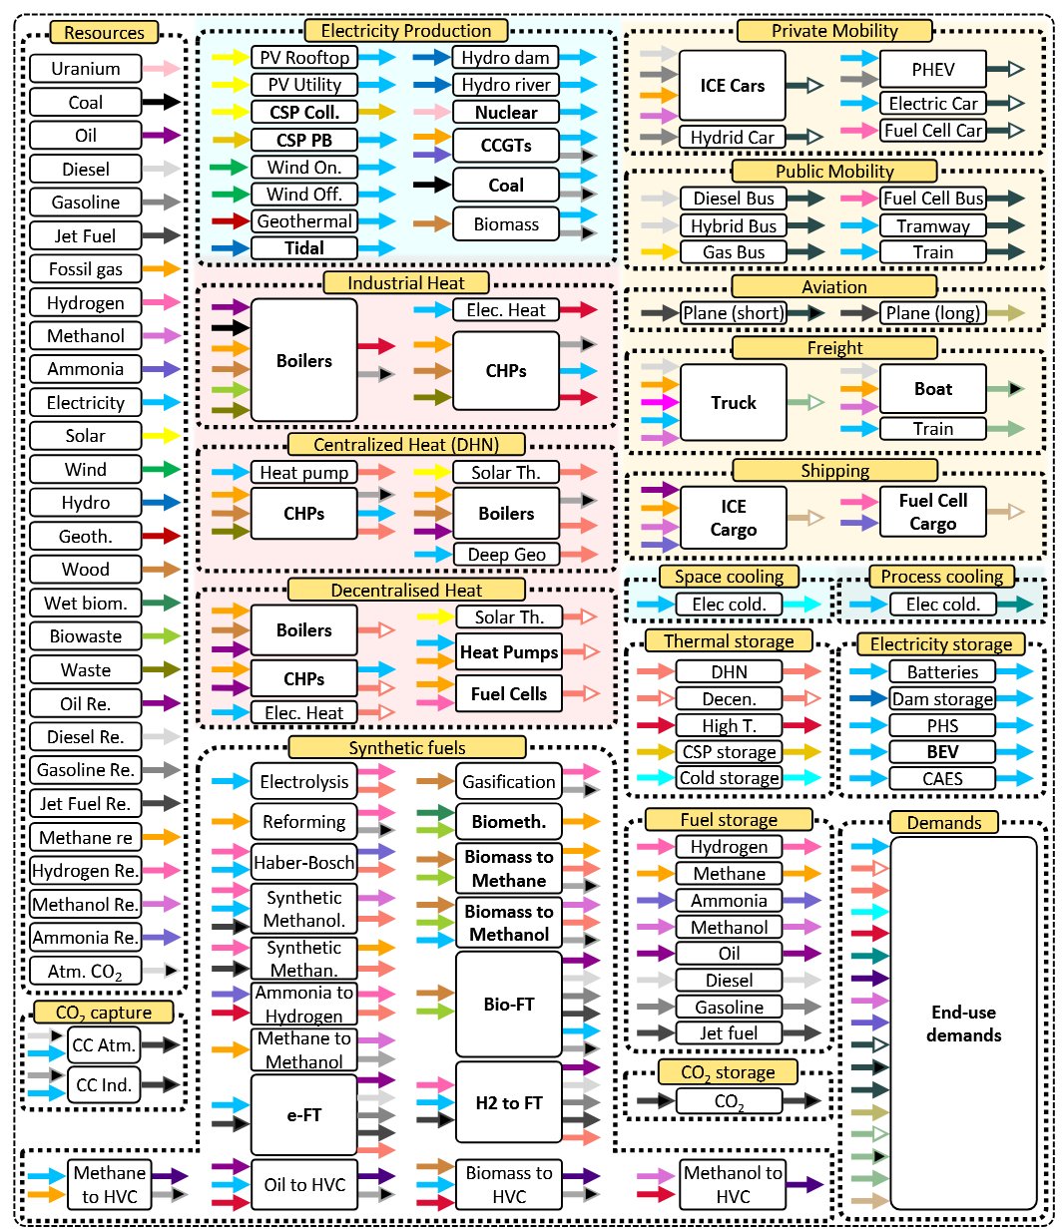
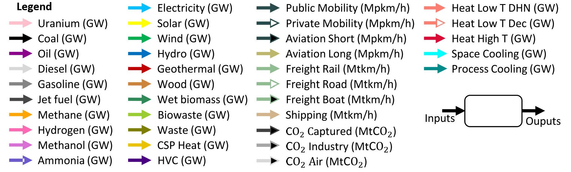
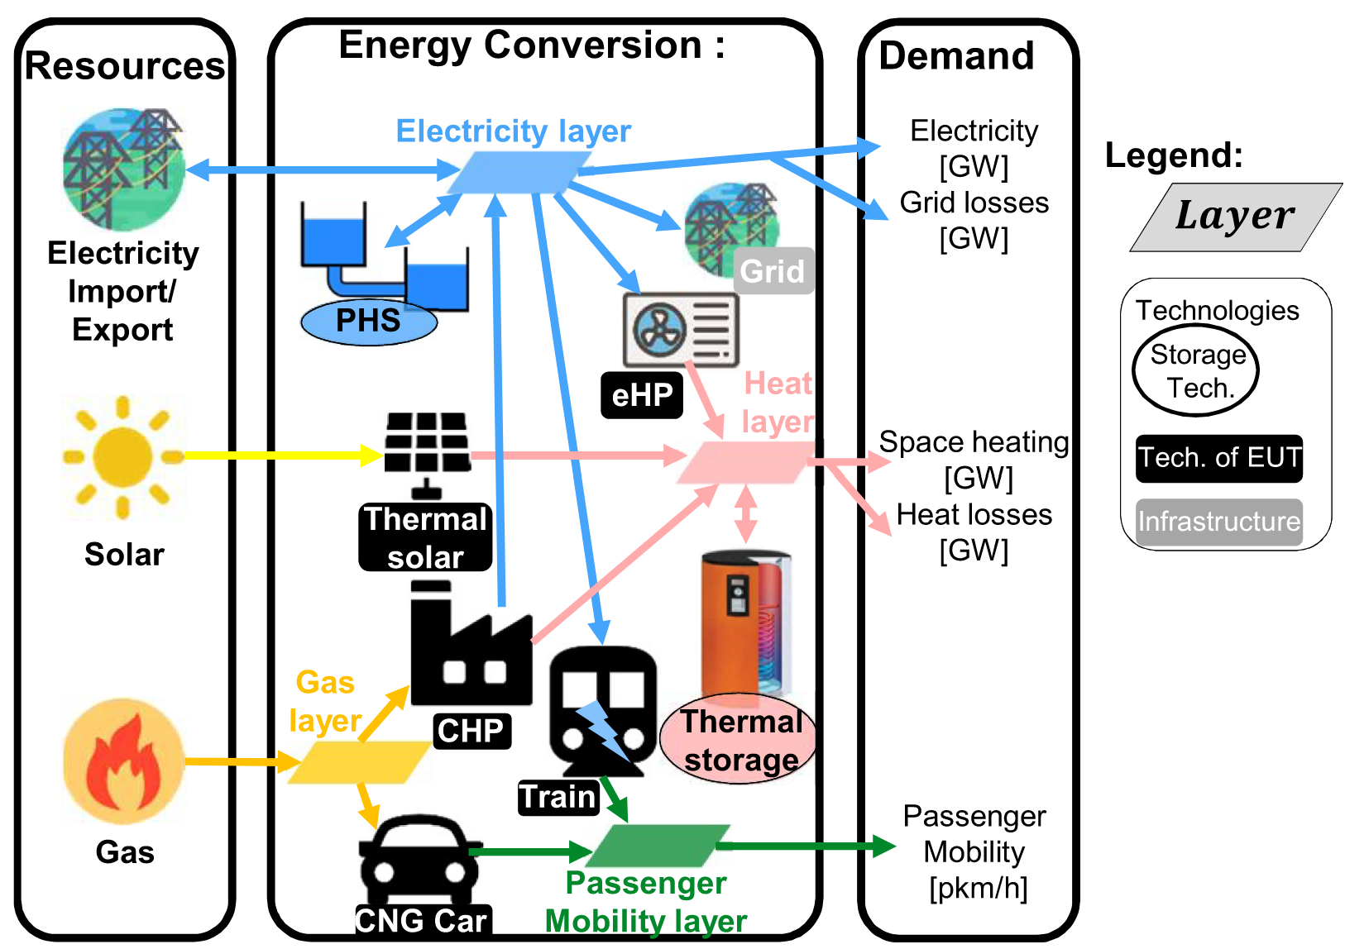
Example of EnergyScope LP Problem representation

Slide 11
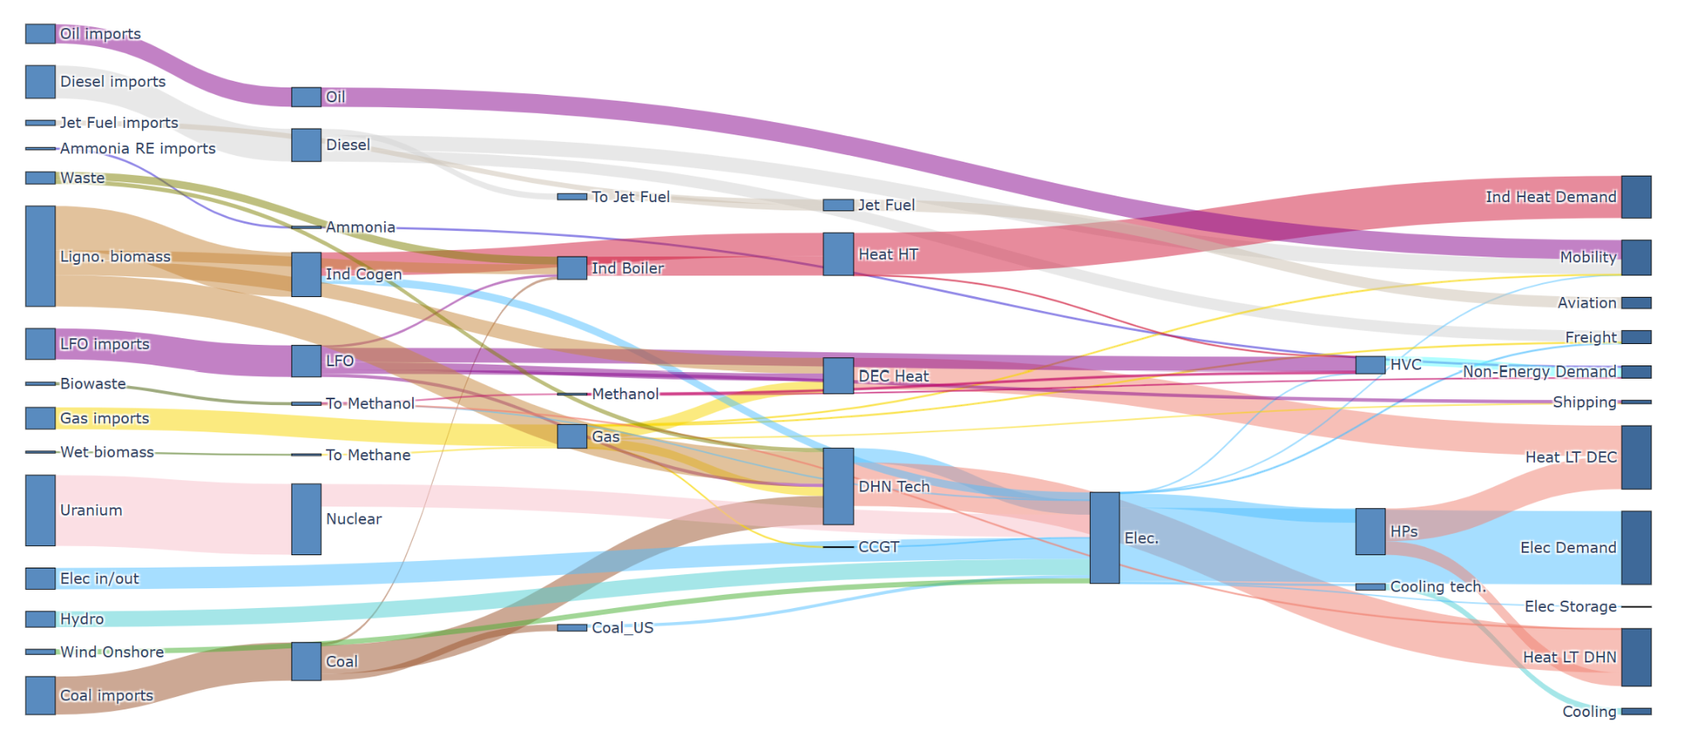
Finish calibration 2017

Slide 12
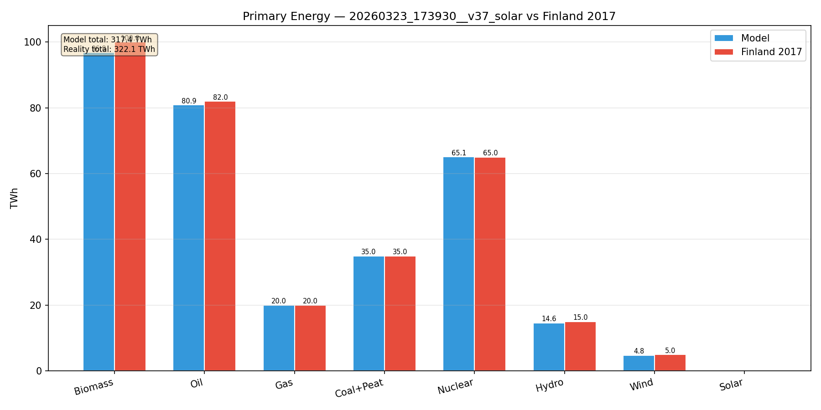
Validation 2017 - Finland - PE

Slide 13
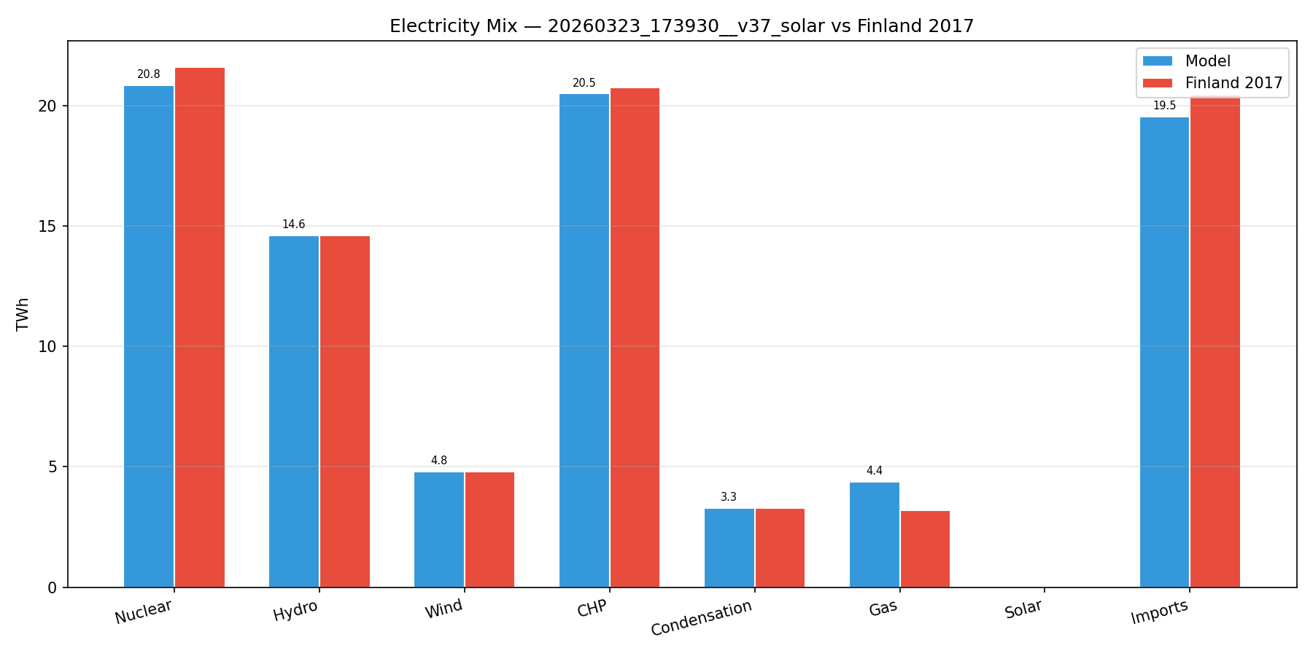
Validation 2017 - Finland - EM

Slide 14
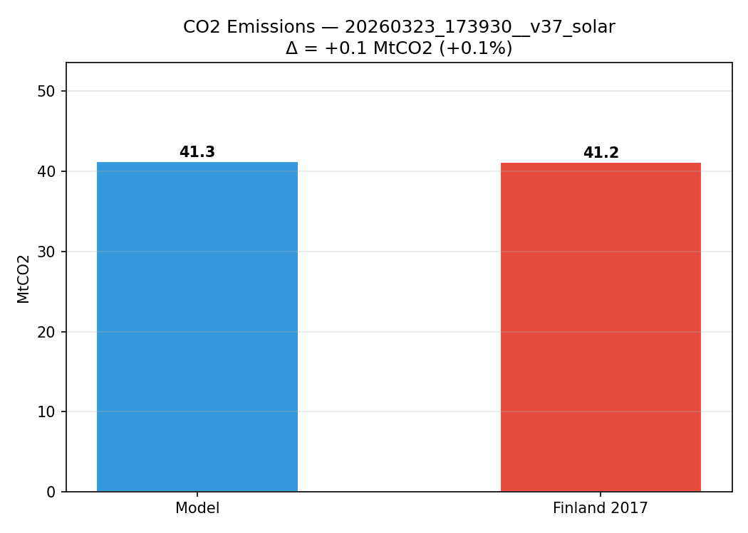
Validation 2017 - Finland - EM

Slide 15
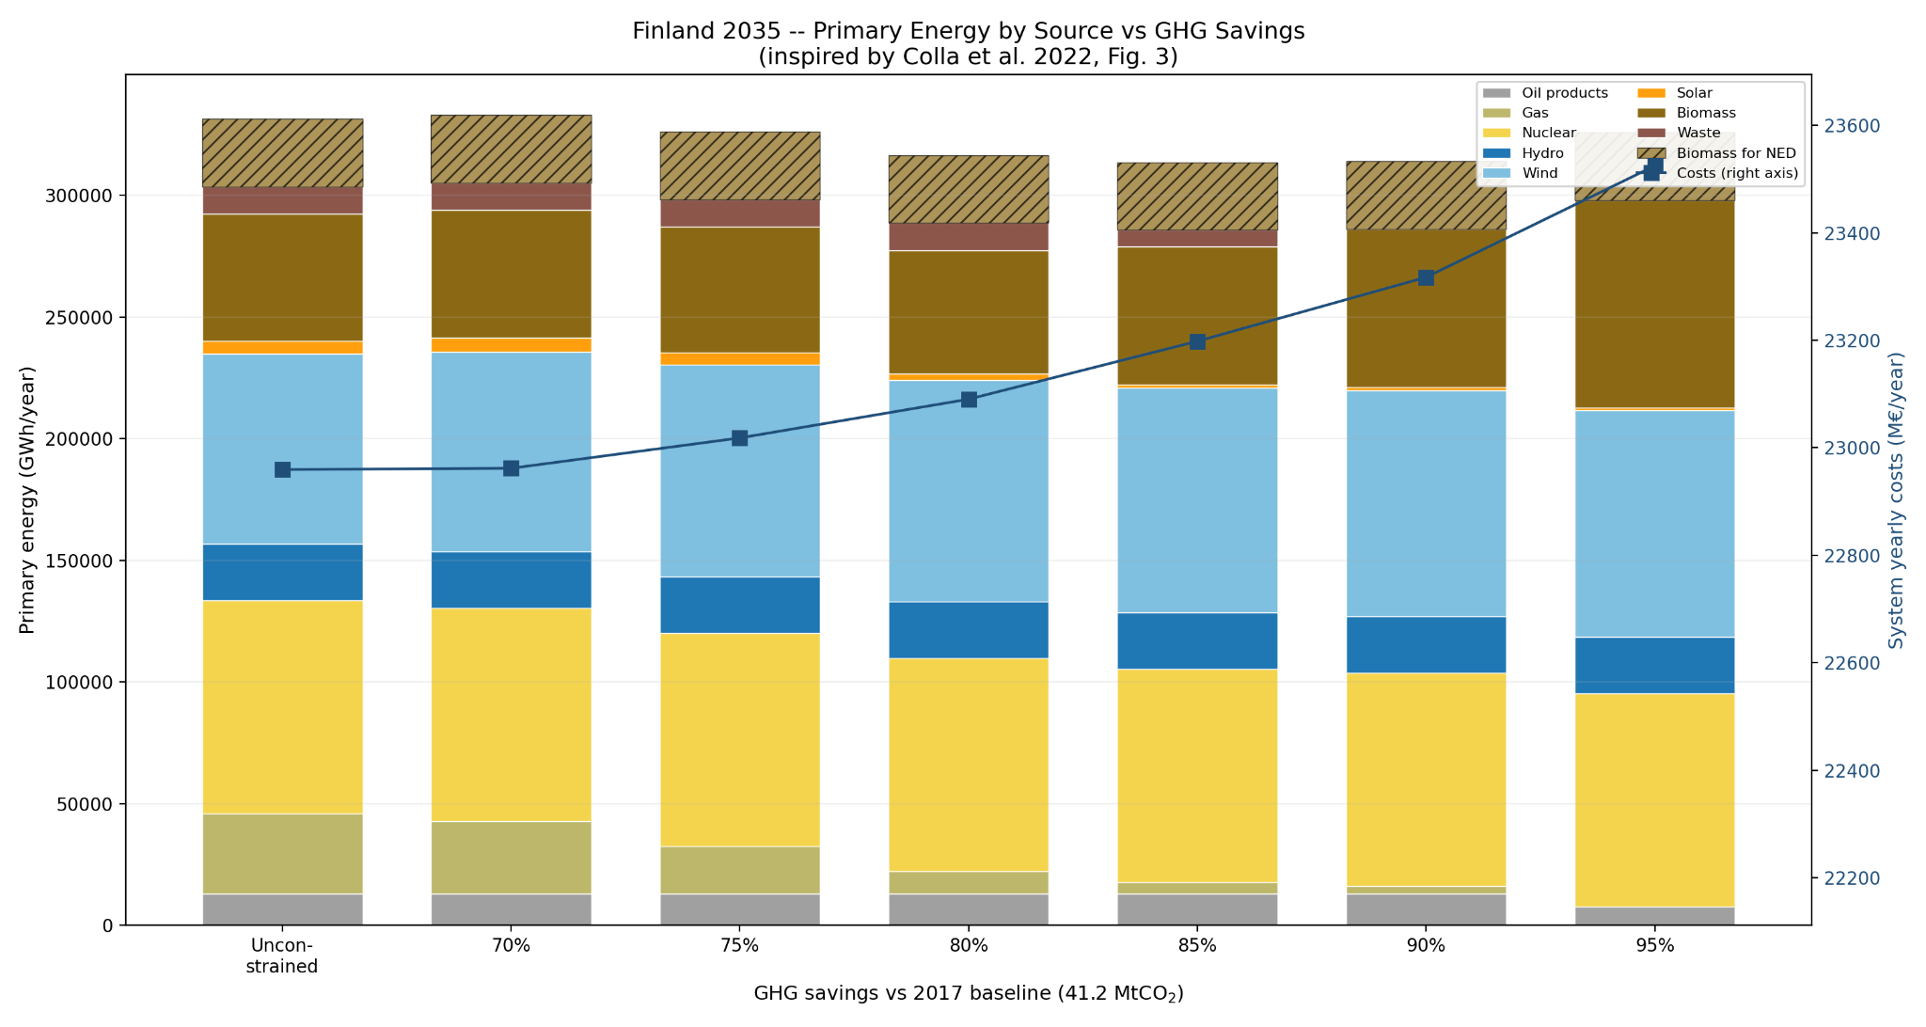
2035 - Finland - Primary Energy mix Exploration

Slide 16
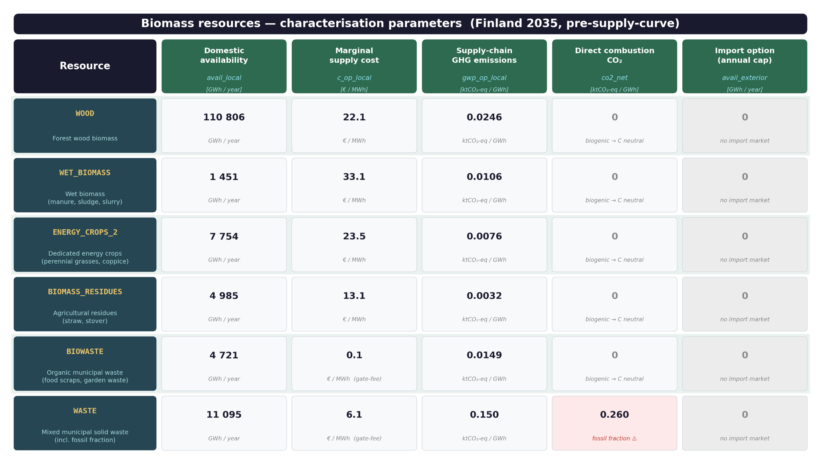

Slide 17
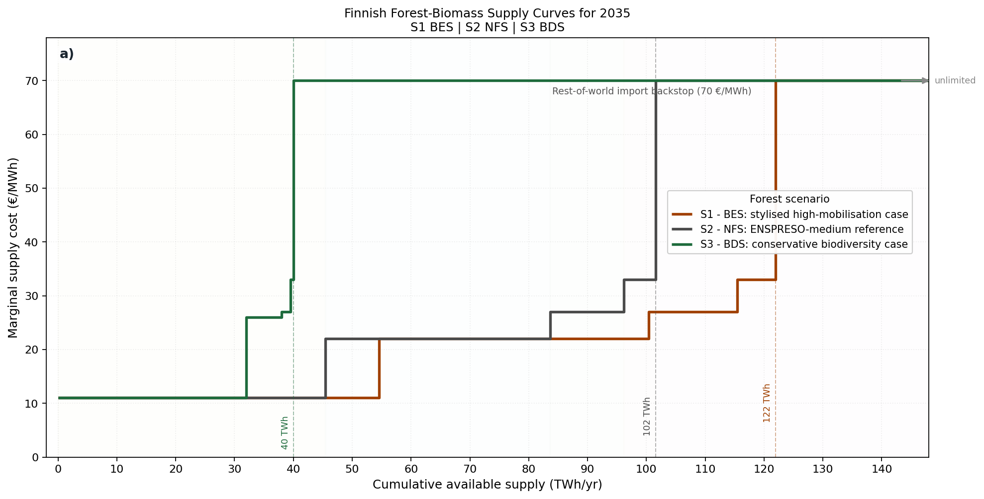
Forest supply curve under different management scenario

Slide 18
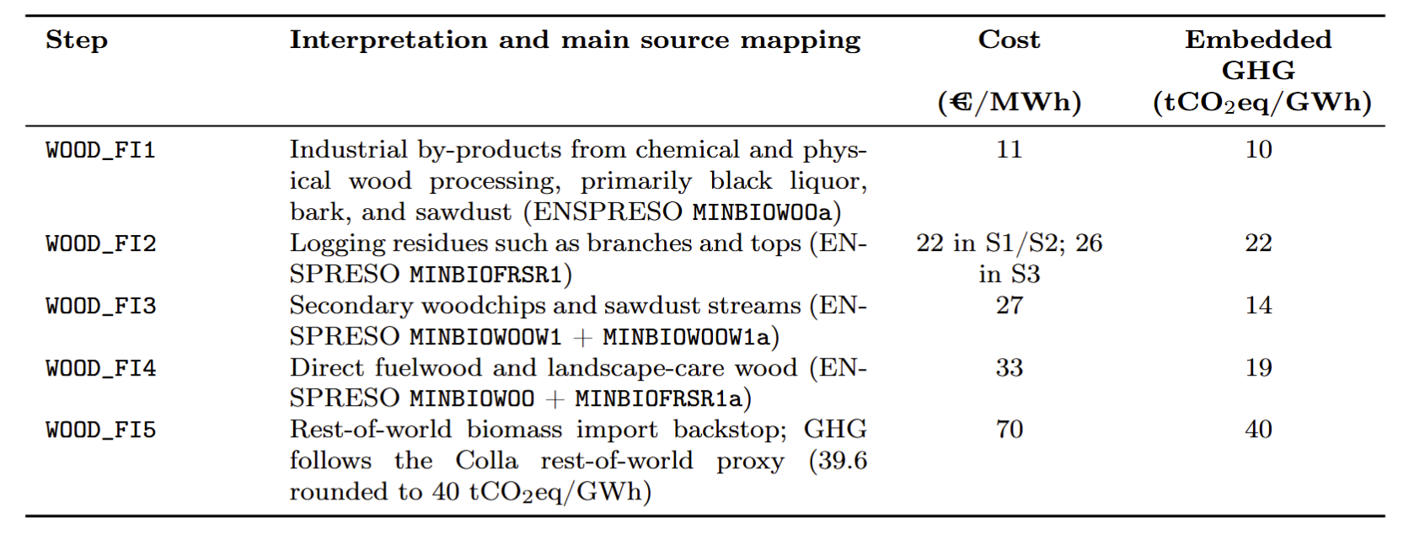
Forest supply curve under different management scenario

Slide 19
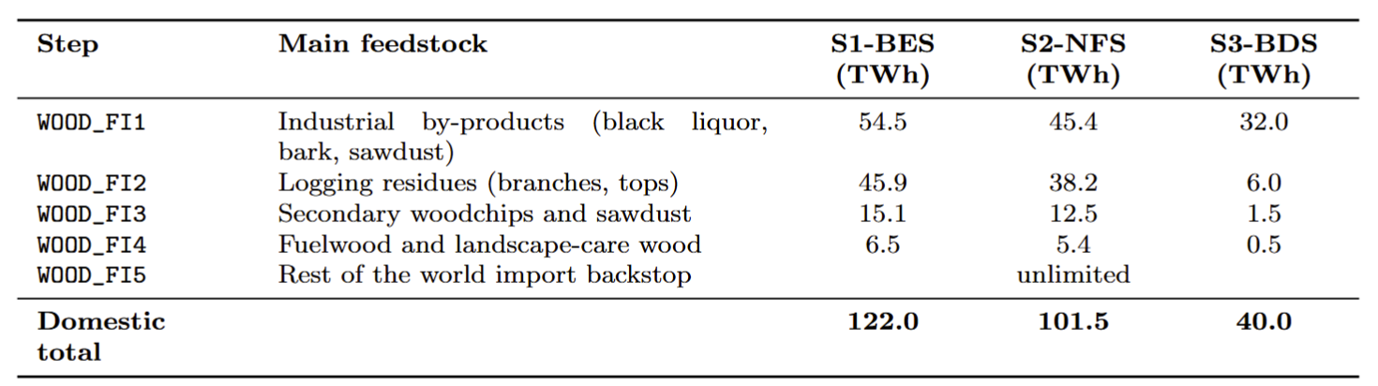
Forest supply curve under different management scenario

Slide 20
X different emission reduction target scenarios
UNCONSTRAINED
MINUS 95 % CO2 emission
MINUS 95 % CO2 emission +
NUCLEAR PHASE OUT

Slide 21
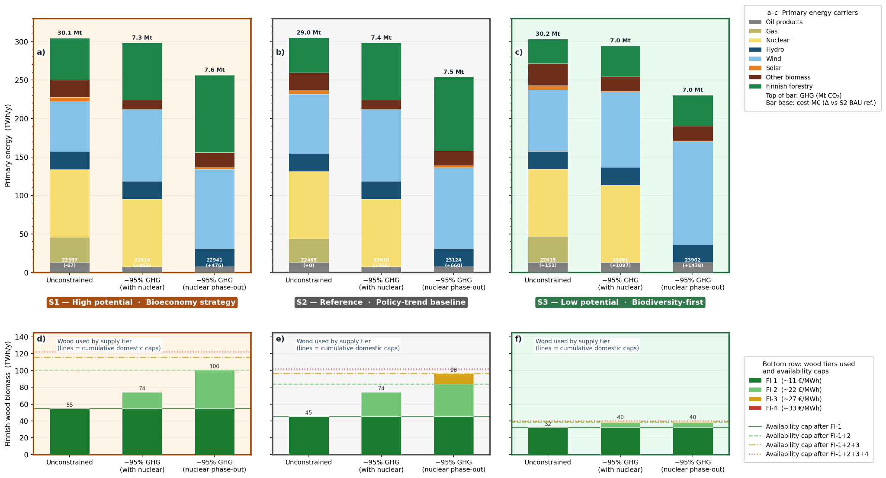
Notes:
In all three unconstrained cases, demand is met entirely by the cheapest biomass source: industrial wood by-products.
Higher-cost domestic biomass is only needed when the climate target becomes stringent.
Removing nuclear substantially increases biomass demand in S1 and S2
(from 74.2 TWh to 100.4 TWh in S1, and to 96.2 TWh in S2),
S3 cannot expand further because its 40 TWh domestic ceiling is already binding, making wind turbine construction and exploitation less costly than the Rest of the world import Backup
(vs S2 BAU reference) tells the story:
S2 unconstrained → 22.5 billions euros per year ±0 M€ (it is the reference)
S1 -95% nuclear phase-out → +476 M€
S3 -95% nuclear phase-out → +1,438 M€ — the most expensive case by far
The forest scenario adds cost; losing nuclear multiplies it.

Slide 22
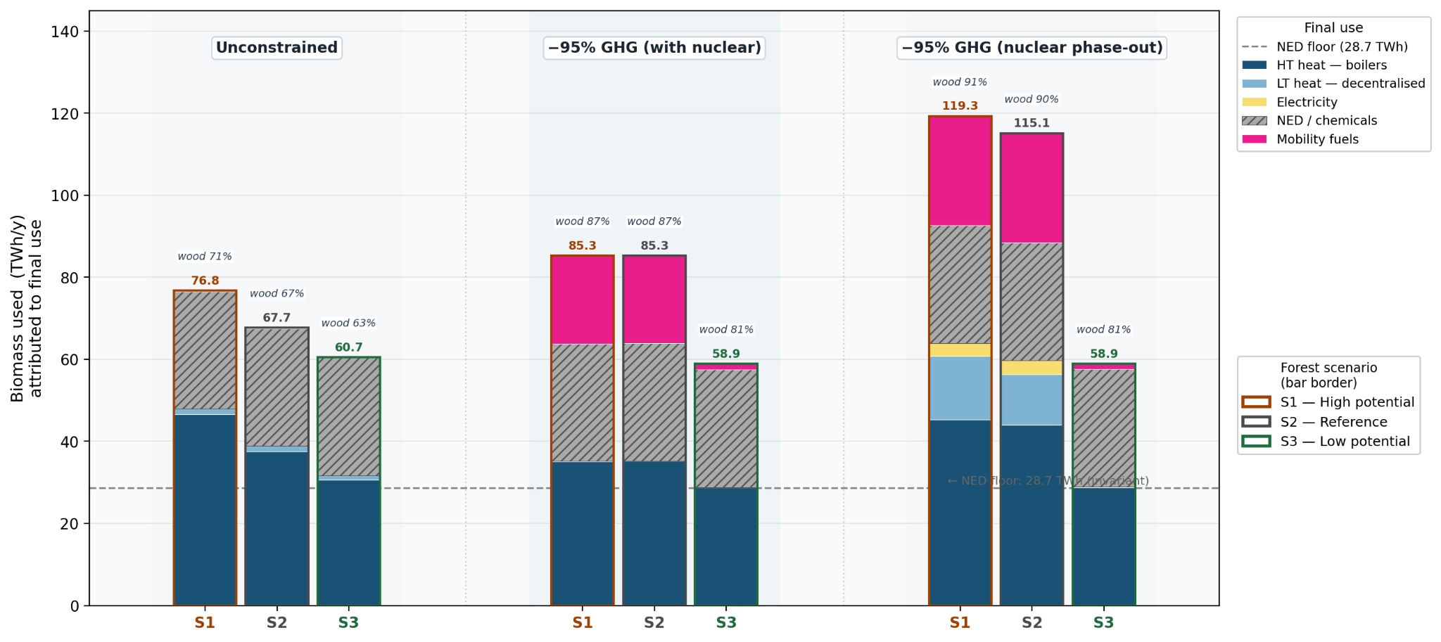
Biomass allocation 2035
Notes:
27.9 TWh is directed to high-value-chemicals production and approximately 0.8 TWh to methanol synthesis across all nine scenarios – a near-constant baseline driven by
exogenous non-energy industrial demand
S1 and S2 converge completely under -95% + nuclear (85.3 TWh each)
At -95% GHG with nuclear, S1 and S2 both land at exactly 85.3 TWh with near-identical allocation. The optimizer finds the same solution regardless of whether wood is available — the constraint is the GHG budget, not the wood supply.
The pink bar (mobility fuels) is near-zero in unconstrained scenarios but becomes the dominant marginal use as the GHG constraint increases
The model is diverting biomass to transport decarbonisation,through Fischer-Tropsch biomass-to-diesel technology — the most difficult sector to electrify, especially when there is no nuclear,
In the case of the hard cap scenario
With wood capped at 40 TWh and nuclear gone, BIOMASS_TO_DIESEL contributes essentially nothing (0.15 GWh, negligible) because the remaining domestic wood is fully absorbed by heating and industrial uses that have no cheaper substitute — so the model decarbonises mobility by route-switching entirely: private cars go 100% battery-electric, road freight goes 100% hydrogen fuel-cell trucks, and international shipping goes 100% ammonia fuel-cell vessels, with all made from wind electricity via electrolysis. Aviation is the one sector the model cannot decarbonise cleanly in this scenario — it falls back on imported fossil diesel + imported renewable diesel converted to jet fuel
Trade off between biodiversity safeguard cap on biomass exploitation and transport decarbonation

Slide 23
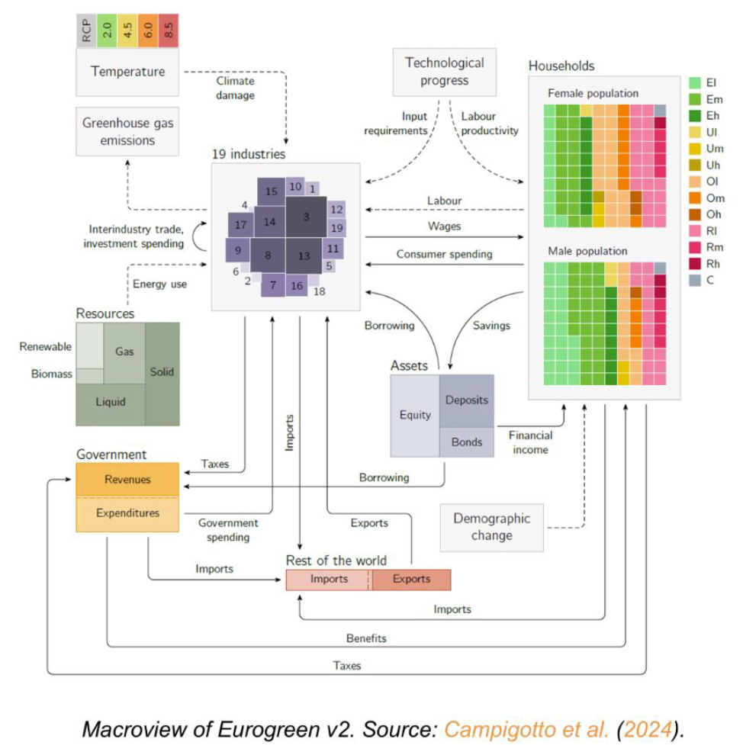
Next Steps
EUROGREEN - Finland
IO, endogenous innovation
Endogenous demand social classes
Macro and Inequality indicators
Soft links, scenarios,
parameters
G4M + FLAM(spatially explicit forest economic physical risk model)
Potentials
Physical risk scenario

